Slide 1






Software Measurement and Analysis
Team Assignment 7
-------=====-------
K15T2 - Team 2
-------=====-------

Slide 2

Contents
Viking Roadmap
Tools To Estimate

Slide 3
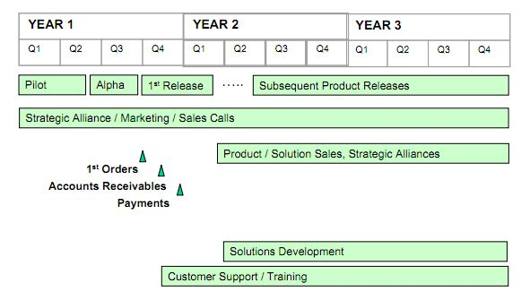
Viking Roadmap

Slide 4
Viking Roadmap

Slide 5
Contents
Viking Roadmap
Tools To Estimate

Slide 6

Tools To Estimate
ROI
Tools Estimate
BREAKEVEN ANALYSIS
IRR

Slide 7

ROI
What is ROI?
ROI (Return on Investment) is a relatively straightforward investment metric that expresses how much time is required (the payback period) to recover the original investment. It may also be expressed as a percentage figure -- ROI%. ROI is calculated as:

Slide 8
ROI
Why is choose ROI?
ROI shows the amount of money you expect to make on a particular investment – and that’s an important thing to know. When you only have a certain amount of money to invest, you’ll want to look at the investment that will return the most money in the shortest amount of time

Slide 9
ROI
Total Cost: 927240 $
Viking Revenue Estimates
Viking License Fee | $650
Viking Dev. License Fee | $1.950
Support Fee | 20%

Slide 10
ROI
Maximum Total Additional: 3338400

Slide 11
 |  | # Licenses |  |  | # Dev. Licenses |  |  | Volume Discount
 | Company | Year 2 | Year 3 | Year 4 | Year 2 | Year 3 | Year 4
Probable (100%) | DefCon USA | 375 | 400 | 550 | 20 | 30 | 40 | 20%
 | Big Communications | 325 | 400 | 550 | 20 | 30 | 40 | 20%
 | Starfleet | 200 | 200 | 350 | 10 | 15 | 25 | 15%
 | Global Energy | 185 | 200 | 350 | 10 | 15 | 25 | 15%
 | Chemicals-R-Us | 55 | 50 | 100 | 5 | 10 | 15 | 15%
 | Additional Viking Licenses | 1185 | 1300 | 2000 | 70 | 110 | 160
 | Additional Revenue from Licenses | $607.100 | $664.625 | $1.014.000 | $103.838 | $159.900 | $232.538
 | Additional Support Revenue | $121.420 | $132.925 | $202.800 | $20.768 | $31.980 | $46.508
 | Total Additional Revenue | $853.125 | $989.430 | $1.495.845

Slide 12
ROI
Minimum Total Additional Revenue (80%): 2670720

Slide 13
 |  | # Licenses |  |  | # Dev. Licenses |  |  | Volume Discount
 | Company | Year 2 | Year 3 | Year 4 | Year 2 | Year 3 | Year 4
Probable (80%) | DefCon USA | 375 | 400 | 550 | 20 | 30 | 40 | 20%
 | Big Communications | 325 | 400 | 550 | 20 | 30 | 40 | 20%
 | Starfleet | 200 | 200 | 350 | 10 | 15 | 25 | 15%
 | Global Energy | 185 | 200 | 350 | 10 | 15 | 25 | 15%
 | Chemicals-R-Us | 55 | 50 | 100 | 5 | 10 | 15 | 15%
 | Additional Viking Licenses | 1185 | 1300 | 2000 | 70 | 110 | 160
 | Additional Revenue from Licenses | $607.100 | $664.625 | $1.014.000 | $103.838 | $159.900 | $232.538
 | Additional Support Revenue | $121.420 | $132.925 | $202.800 | $20.768 | $31.980 | $46.508
 | Total Additional Revenue | 682500$ | 791544$ | 1196676$

Slide 14
ROI
Revenue
 | Year 2 | Year 3 | Year 4 | Total
Maximum Total Additional Revenue (100%) | 853125$ | 989430$ | 1495845$ | 3338400$
Minimum Total Additional Revenue (80%) | 682500$ | 791544$ | 1196676$ | 2670720$

Slide 15
ROI
ROI calculation:
 | Total Cost | Total Benefit | ROI (%)
Maximum Total Additional Revenue (100%) | 927240$ | 3338400$ | 260,04%
Minimum Total Additional Revenue (80%) | 927240$ | 2670720$ | 188,02%

Slide 16
Tools To Estimate
ROI
Tools Estimate
BREAKEVEN ANALYSIS
IRR

Slide 17
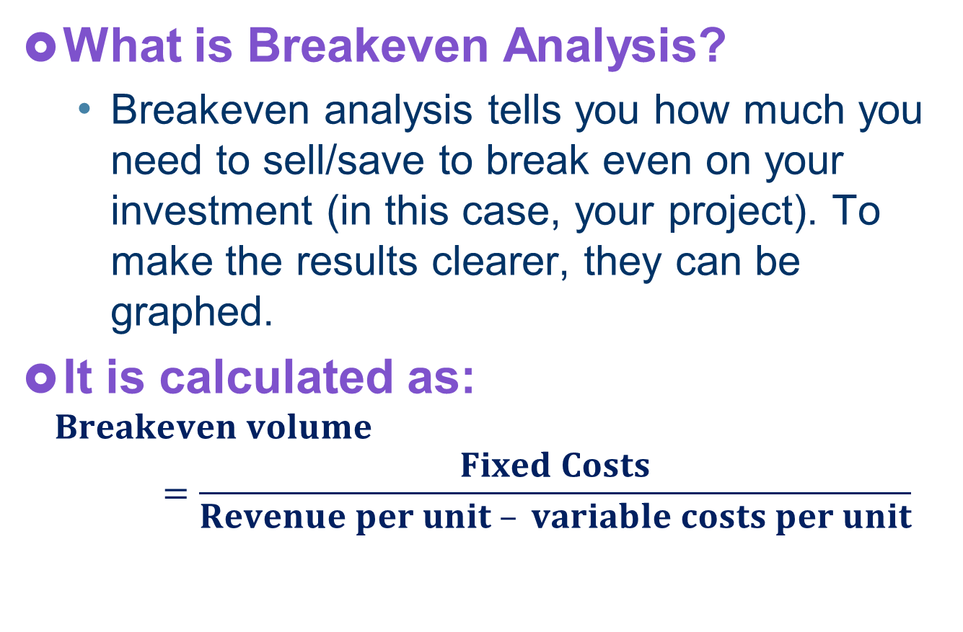
BREAKEVEN ANALYSIS
What is Breakeven Analysis?
Breakeven analysis tells you how much you need to sell/save to break even on your investment (in this case, your project). To make the results clearer, they can be graphed.
It is calculated as:
$$Breakeven volume=\frac{Fixed Costs}{Revenue per unit – variable costs per unit}$$

Slide 18
BREAKEVEN ANALYSIS
Why is choose Breakeven Analysis?
Breakeven analysis helps to provide a dynamic view of the relationships between sales, costs and profits

Slide 19
BREAKEVEN ANALYSIS
Total cost: 927240
Breakeven analysis calculation:
For Viking License Fee: 650 $
For Viking Dev. License Fee: 1950$
Total Cost | Breakeven analysis
927240 | 1427
Total Cost | Breakeven analysis
927240 | 476

Slide 20
Tools To Estimate
ROI
Tools Estimate
BREAKEVEN ANALYSIS
IRR

Slide 21
IRR
What is IRR?
IRR (Internal rate of return) is often used in capital budgeting, it is the interest rate that makes net present value of all cash flow equal zero.

Slide 22
IRR
Why is choose IRR?
IRR is an indicator of the efficiency, quality, or yield of an investment because the internal rate of return is a rate quantity.

Slide 23
IRR
 | Year 1 | Year 2 | Year 3 | Year 4 | IRR
Maximum Total Additional Revenue (100%) | -536570 | 792375 | 928680 | 1226675 | 152%
Minimum Total Additional Revenue (80%) | -536570 | 621750 | 730794 | 927506 | 116%

Slide 24
Thank You!

